Slide 1
Introduction
Reports
Emergency
Save Nature
Emergency Crew

Slide 2
Emergency (Report)
Fire
Crime
Ambulance
Save Nature
https://github.com/lukasnamupala/emergency2017.git
Emergency Crew

Slide 3
Response
Police
Paramedics
Nature Conservancies
Fire Brigades
https://github.com/lukasnamupala/emergency2017.git
Emergency Crew

Slide 4
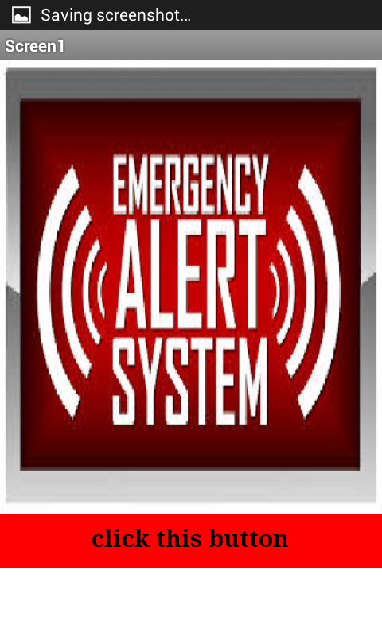
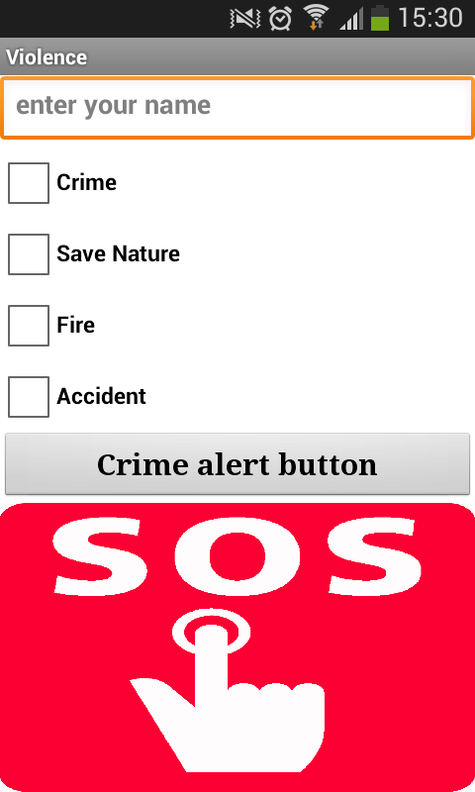
Application Screenshots
https://github.com/lukasnamupala/emergency2017.git
Emergency Crew

Slide 5
Future Work
Separate Servers
Attach Crime type
Feedback
https://github.com/lukasnamupala/emergency2017.git
Emergency Crew

